Slide 1


Becoming smart about Democratic challenges and disinformation
Version for use with learners
2025

Slide 2
Table of contents
(All the images used are copyright free)
Session 1 – concepts and ideas
Session 2 - Exploring quizzes
Session 3 - Eunope videogame
Notes:
For teachers in the project. this presentation needs to be followed as closely as possible, for comparison perspectives. Also the pre and post test will verify only 10 competences out of the 24, as they overlap both the game and series of quizzes. These competences are : 2 3 10 11 14 15 19 20 21 and 22

Slide 3
1. Concepts and ideas
Initial questionnaire, debate and core definitions

Slide 4

Link to questionnaire
Initial questionnaire
Notes:
For teacher: reassure the students: they will not be graded on this. They are going to be part of a European project called Algowatch. The basic objective is to make them information smart and AI –Savvy! They will be given the results of the whole comparison with their peers in Ireland, France, Croatia and Portugal.

Slide 5
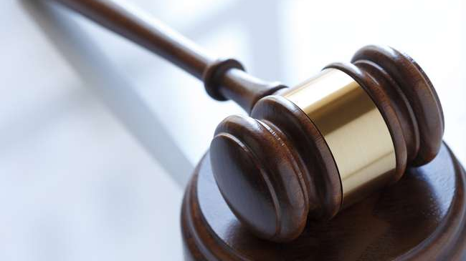
Debate
If an AI system were to take power in the world, what would be the first law it would introduce?
Notes:
1. Teacher: this is a short ice-breaker, eye-opener: not more than 10 minutes. If you start your session late, it can be dropped. Pointers to start the conversation : Would the situation put democracy at risk? Who would have the means to resist and how?

Slide 6
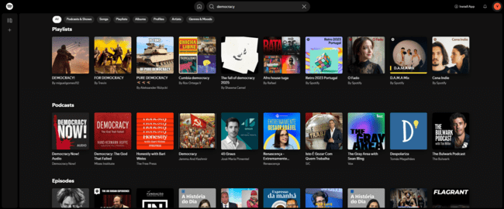
How does the recommendation system work?
Notes:
1. For teachers: make sure the students remember words such as reactions, engagement, navigation history, browsing

Slide 7
Display results following…
Your past browsing history
The media you have skipped
The media you have liked
Posts you have shared on social media
Your personal playlists
Your location

Slide 8
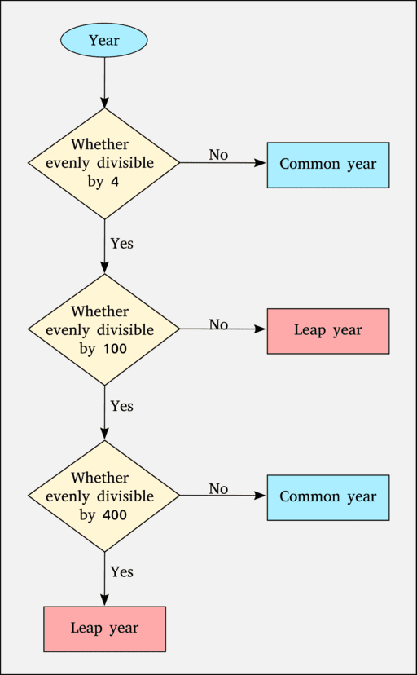
Algorithm
As related to digital platforms, algorithms are tools that select what content is displayed for users based on relevance and preferences.
(European Commission, 2022)
Photo: Sanu N, CC BY-SA 4.0 <https://creativecommons.org/licenses/by-sa/4.0>, via Wikimedia Commons

Slide 9
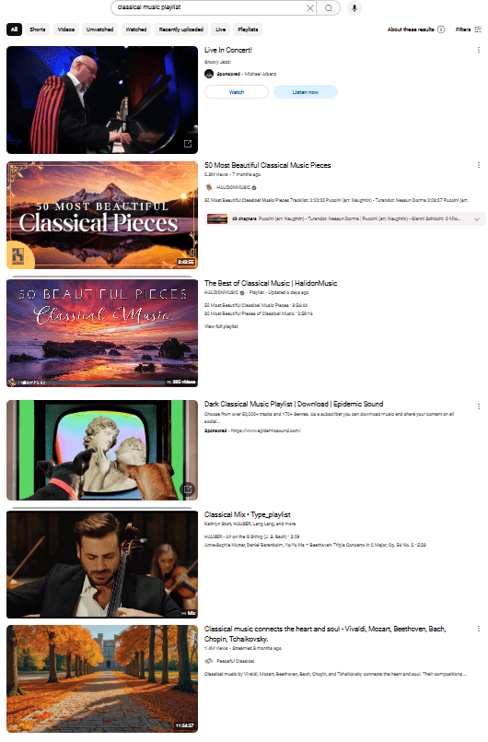
Recommendation algorithms
Highlight personalized content according to each user’s reactions, engagement and navigation history

Slide 10

Browsing
It’s like casually exploring websites, social media, or videos to see what interests you or to discover new things.
Notes:
1. Act of looking through or scanning information, usually online, without a specific goal in mind.
2. Your browsing preferences and navigation habits are compiled in your user profile by the search engines and social media algorithms.
3. Teachers: important to ensure that the students are aware of the user profile and how it is compiled: navigation history, habits, likes and dislikes, location, time spent online…

Slide 11

Engagement
Online engagement can vary, depending on behaviour through, for example, comments, shares, likes, and downloads...
Notes:
1. For teachers, full definition is here: engagement refers to the quality of the connection and interaction that an audience has with a particular content, which can involve emotional investment,
cognitive involvement, and interaction such as comments and shares. For students important to underline the students’ behaviour (useful for the game): comments, shares, likes, downloads… (Lim & Chai, 2015)
(Lim & Chai, 2015)

Slide 12
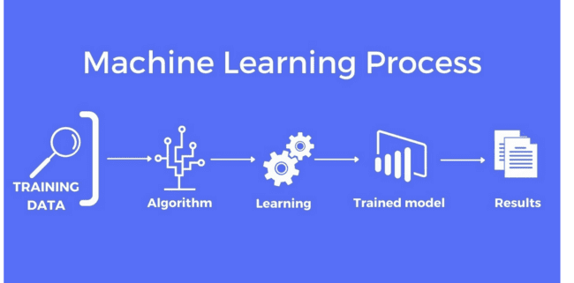
Source: Mapendo
Notes:
1. For teachers: Machine learning and AI is the ability of a computer system to learn, extract patterns and change in response to new data, without the help of a human being. (European Commission, 2022)

Slide 13

AI & AI systems
AI refers to computer programs that seek to imitate how humans solve problems, analyze data, create, have conversations, etc.
AI systems results can be difficult to distinguish from content created by humans
Notes:
1. For teachers: additional information from the AI Act: … they can “generate outputs such as content, predictions, recommendations, or decisions influencing the environments it interacts with.
If teachers have time they can take the students on the tokenizer of open AI to show them how the system gets trained by natural language .: https://platform.openai.com/tokenizer

Slide 14

Prompt
Can you write a poem in the manner of Paul Verlaine that evokes the risks of disinformation for democracy?
Notes:
1. A prompt is a specific instruction or question that guides the LLM in generating a response. It can take the form of a sentence, phrase, or question that directs the model's output.
2. For teachers: the Prompt can be tested during the workshop. However, if you believe that the activity will take too much time, you can prepare it in advance and present the results on an additional slide.

Slide 15
AI systems can…
Have biases
Show discrimination
Make mistakes
Use data that belong to you or others without having asked for permission

Slide 16
Prompt
Draw me a handicapped person.
Notes:
1. The result of this prompot in on the next slide.

Slide 17
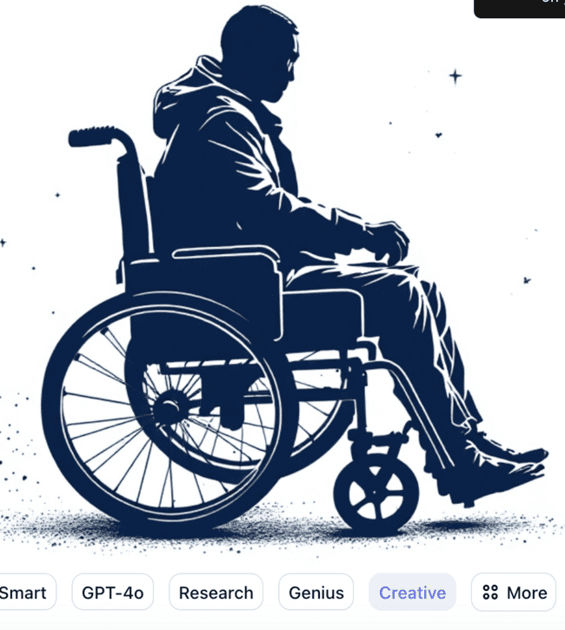
The image (generated via Youcom) shows a person in a wheel-chair, by default.
AI systems can have biases if they are trained with data that are also biased.
Notes:
Teachers: additional information: … they can “generate outputs such as content, predictions, recommendations, or decisions influencing the environments it interacts with.
If teachers have time they can take the students on the tokenizer of open AI to show them how the system gets trained by natural language .: https://platform.openai.com/tokenizer

Slide 18
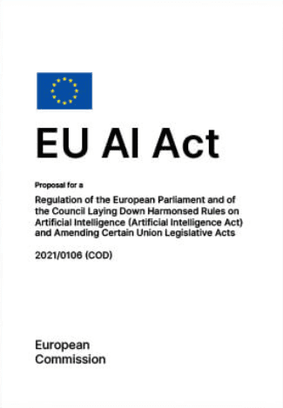
AI Act
Aims to ensure that AI systems providers:
- respect the classified levels of “risk”
- follow the mandatory requirements
Particular attention is paid to data privacy of users as well as deepfakes.
Notes:
1. Legal framework to ensure that AI systems providers respect the classified levels of “risk” (to fundamental rights of individuals in particular) and follow the mandatory requirements.
2. For teachers: additional information from the AI Act: … they can “generate outputs such as content, predictions, recommendations, or decisions influencing the environments it interacts with.
If teachers have time they can take the students on the tokenizer of open AI to show them how the system gets trained by natural language .: https://platform.openai.com/tokenizer

Slide 19
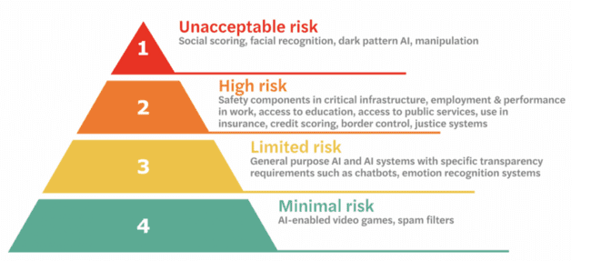

Slide 20
What did you discover ? What do you remember ?
Notes:
1. Suggestions to teachers, to elicit students’ recollection and imaginaries as well as ideas for coping and resisting: role of algorithms ; action is possible because AI Act exists, platforms can be asked to be more transparent…. Remember the competences that are being put in place.

Slide 21
2. Exploring quizzes
Fake news, Disinformation, digital citizenship

Slide 22

Disinformation
Verifiably false or misleading information that is created, presented, and disseminated for economic gain or to intentionally deceive the public... It can cause public harm and be a threat to democratic processes and to health, security, environment.
(European Commission, 2022)

Slide 23
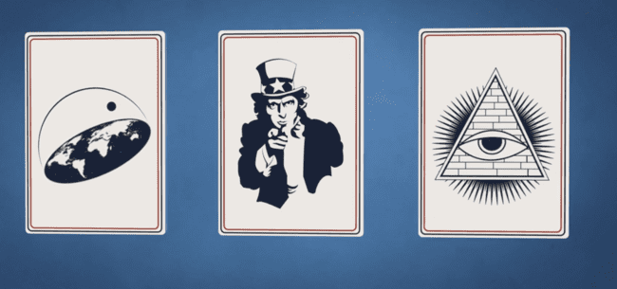
Myth Propaganda Plot theory
@savoirdevenir
Notes:
1. Teachers: from the EU Code of Practice on Disinformation. See the video from which visual has been taken, by Savoir Devenir : https://www.youtube.com/watch?v=iHStw8yY_PU&t=42s

Slide 24
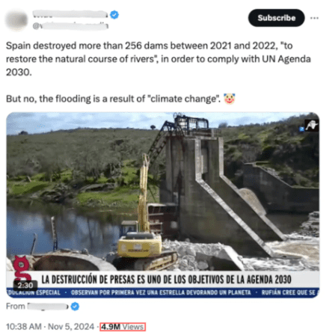
Fake news fuel conflicts
Disinformation claiming that the destruction of dams in recent years by the government has been responsible for the DANA phenomenon in Valencia and eastern regions of Spain in October 2024, is false.
Notes:
1. The full story is available here: https://maldita.es/malditobulo/20241129/hoax-demolition-dams-dana-ue-x/
2. To be localized but the idea has to remain threat to democracy
3. The disinformative narrative, about a specific event in Spain, has become an international hoax. Content with messages against the European Union and the supposed destruction of dams circulates on Twitter (now X) with millions of views and in at least eight languages: Dutch, English, French, German, Italian, Portuguese, Spanish and Turkish.

Slide 25
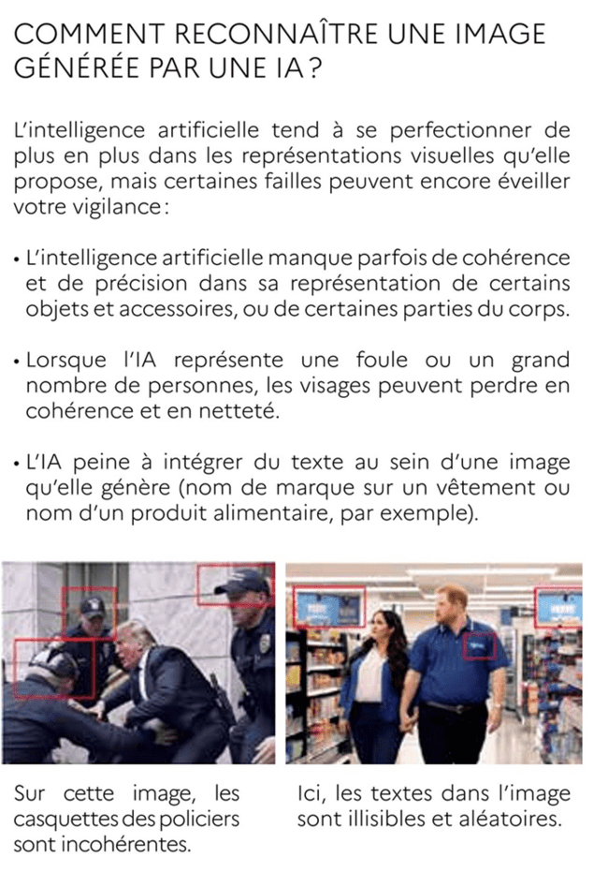
Deep fake
Images, videos or audio recordings generated by Artificial Intelligence, of people or events that did not really happen and that are often impossible to distinguish from the real ones.
(European Commission, 2022)
Notes:
1. This example has been localized to French. You can take other examples or keep the two images in this example and change the text to English.

Slide 26
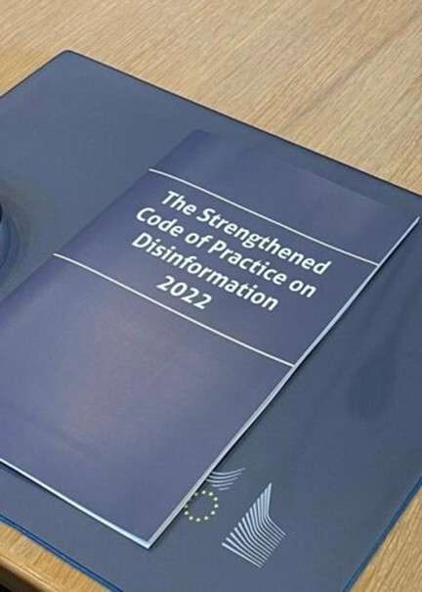
Code of Practice on Disinformation of EU
Signed in 2022, its purpose is to:
- Prevent ads with false content from bad actors
- Help consumers with transparency of political ads
- Limit platform use by fake bots and fake accounts.
Notes:
1. It shows that the battle against disinformation is the responsibility of all. It empowers users with information, tools and support.

Slide 27
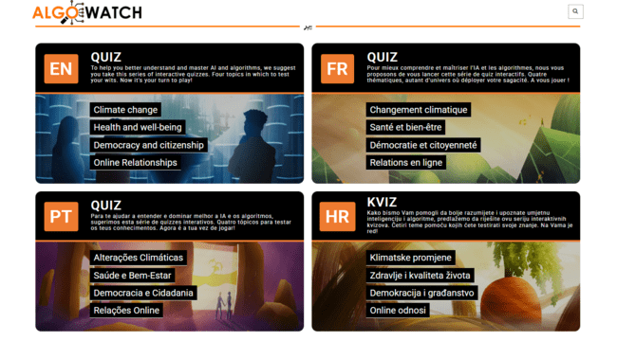
Playing with the quizzes
Notes:
1. Full content of the quizzes (proposed activities, competences addressed, good answers, feedback provided to the player for correct and incorrect answers) available here. LINK AND FILE LACKING
2. ENGAGING STUDENTS WITH THE QUIZZES:
- Choose one student to lead the online quiz on a shared screen.
- Assign another student to read the questions aloud to the class.
- Designate a third student to record the results of each response.
- Encourage the rest of the class to take notes on i) their understanding of the content; ii) the answers to questions they answered correctly and incorrectly
3. Organize a short debate with the students that should focus on topics such as:
What they learned about disinformation, democracy, and citizenship.
Behaviors to observe when interacting online (ethics, safety, AI Act…).
Actions to take in support of the community.

Slide 28
What did you discover ? What do you remember ?
Notes:
1. Suggestions to teachers, to elicit students’ recollection and imaginaries as well as ideas for coping and resisting: role of algorithms ; action is possible because AI Act exists, platforms can be asked to be more transparent…. Remember the competences that are being put in place.

Slide 29
Why disinformation works (I/2)
We believe in what feels right (Schwarz et al., 2017).
We want to confirm what we already think and believe - confirmation bias (Flynn et al. 2017).
We like to trust people we know (Schwarz et al., 2017).
We like to think fast and superficially - hard to think slowly and critically (Kahneman, 2012).

Slide 30
Why disinformation works (2/2)
A strong story gets stuck more easily than cold facts (Lewandowsky et al., 2012).
A repeated history makes us think that many people say the same thing (Schwarz et al., 2017).
Critical thinking requires subject specific knowledge (Nygren et al 2018).
Easy to be confident when ignorant (Dunning & Krueger, 1999)

Slide 31
3. Eunope videogame
Fact-check, videogame, final questionnaire
Conclusions on digital citizenship and how to become smart about Democratic challenges

Slide 32
What can be done to counter disinformation via algorithms and AI?

Slide 33
What can be done to hinder the spread of rumours and fake news?

Slide 34
Think and act like a fact-checker
Who is behind this information? Double check the credibility of the source and the reliability of the websites (go to factchecking websites when in doubt).
What is the evidence? Is it a direct report from the incident or further reporting of a news story from another source?
What do other sources say? Can you find the same news on other news sites that independently confirm or contradict the information?
Always ask the AI system you use to provide its source, after all your prompts… And double-check the source provided !

Slide 35
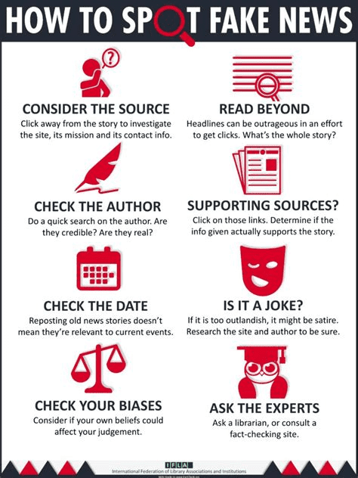
Keep your checklist!

Slide 36
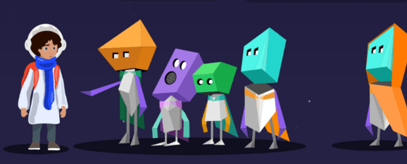
Playing the video game Eunope
Notes:
1. Designed to empower students to evaluate critically the information they encounter through algorithmic recommendations, rankings, and generative AI.
2. Set on the alien planet of Eunope, the game follows the journey of the protagonist, human, as they help the Eunopeans uncover and understand the influence of algorithms and AI in their daily lives.
3. The game’s objective is to uncover the truth behind various rumours received by the player while interacting with the aliens. Each rumour provides a series of clues that the player must investigate and piece together to reveal the reality.
4. GAME SET UP & GUIDELINES HERE: https://docs.google.com/document/d/1BYFXfTv4XusXTu2zOSh5ezHXpzLcO8St/edit?usp=sharing&ouid=106349609074524954985&rtpof=true&sd=true

Slide 37
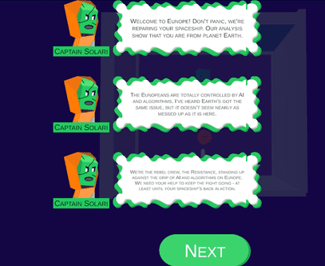
Playing Eunope
Set in an open-world, the game’s objective is to uncover the truth behind various rumours received by the player while interacting with the aliens.
Notes:
1. For teachers: The activity sheet should make it easier to have all students concentrate. Only the mini-games will be played for the intervention. The students may continue playing the game after the end of the session or at home as soon as it will be available online.
2. Engaging students with the video game and minigames:
- Organize the students by groups of two or three. Give them the activity sheet for the mini-games.
- Designate a student to record the results taken and fill in the activity sheet.
- Encourage the class to take notes on i) their understanding of the content; ii) the change in the characters' behaviors in the game.
3. Organize a short debate with the students that should focus on topics such as:
What they learned about disinformation, democracy, and citizenship
Behaviors to observe when interacting online (ethics, safety, AI Act…)
Actions to take in support of the community

Slide 38

Do you feel more informed about democratic challenges and disinformation now?

Slide 39

Be smart about algorithms!
Ethics: Algorithms and fake news sometimes form dangerous relationships
Sources: Fake news can destabilize democracies
Pluralism: Not all algorithms are the same (ranking, recommendation, prediction)
Remember that algorithms are very smart at making profits
It's possible to act rather than cope. Take action!

Slide 40

Be smart about AI!
Ethics : check the quality of information input to any AI system (it guarantees the output)
Sources: always conclude your prompt by asking the AI for its source (and double-check it)
Pluralism: avoid relying on a single AI system (not just ChatGPT, but also Llama, Mistral, …)
Remember that AI systems are a tool (they are not human, they have no feelings, …)
AI does not pursue truth and lacks emotions (so be wary of disinformation)

Slide 41
Final questionnaire
link

